Slide 1
MSc Data Science
Energy Consumption Analysis and Optimizations for Scottish Councils

Slide 2

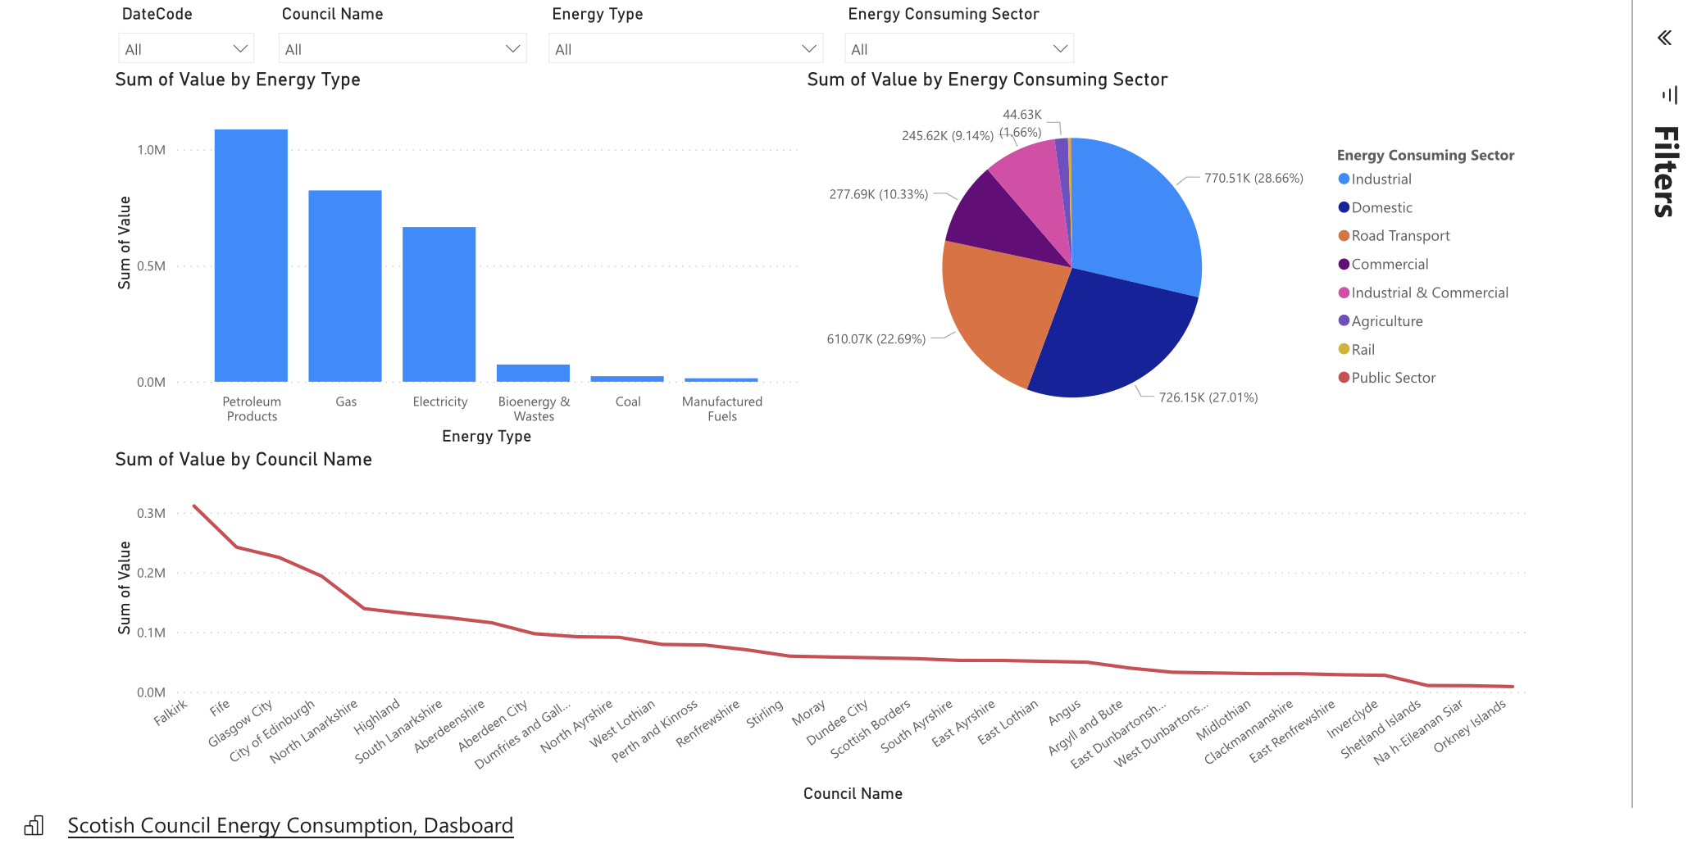
Microsoft Power BI Dashboard

